Slide 1
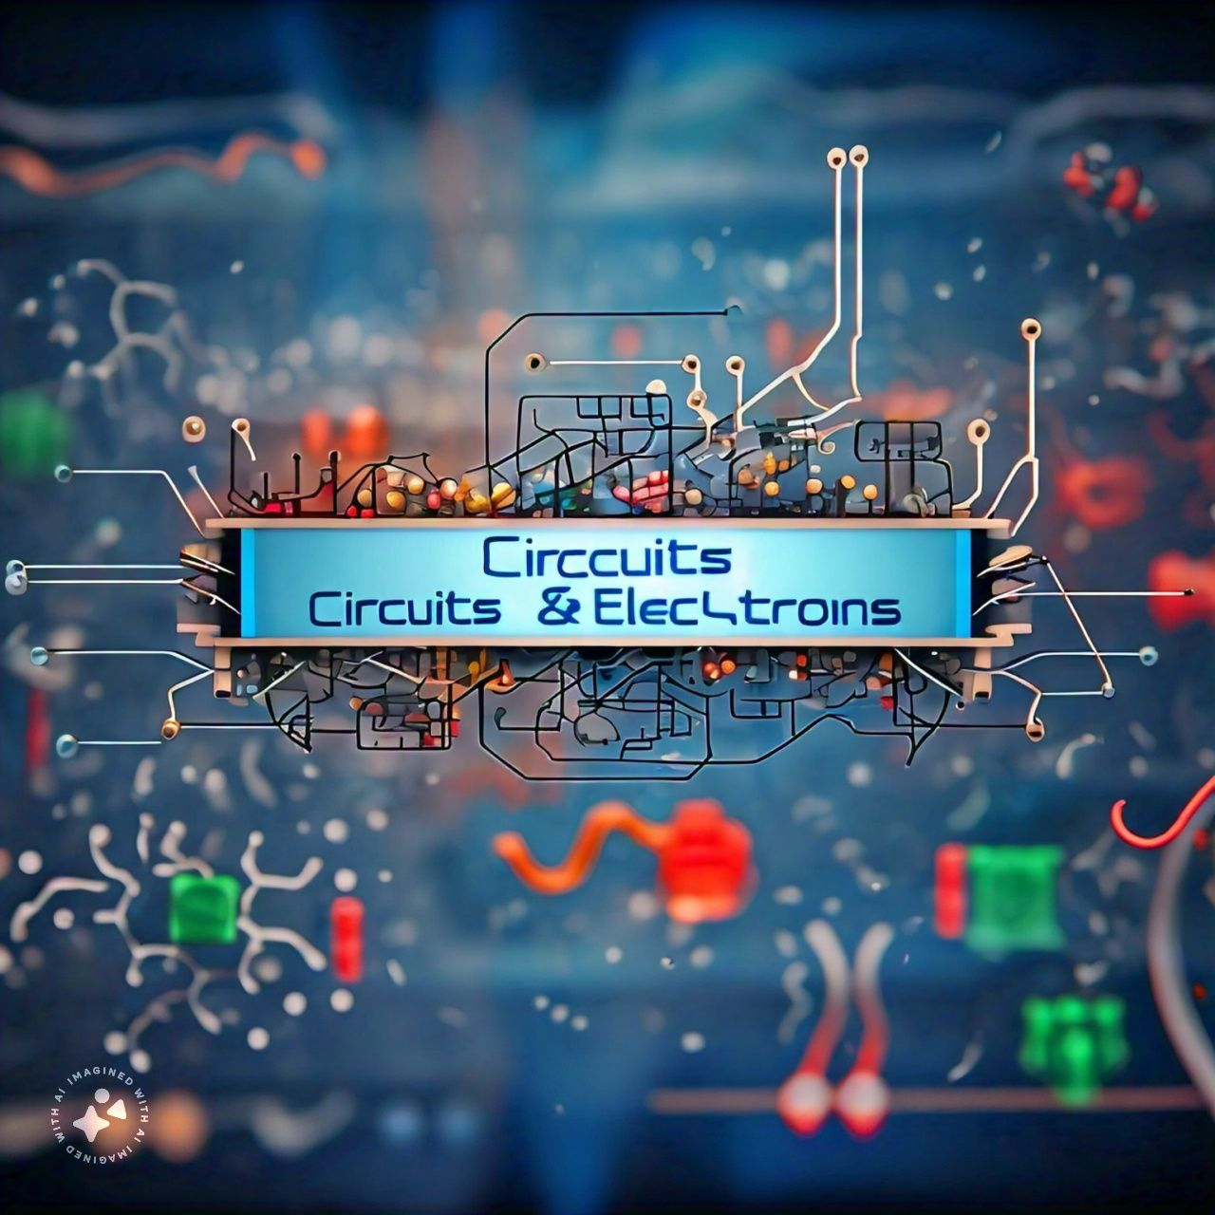
Clamper Circuit
Presented by : Uzair Ahmed Solangi

Slide 2

Clamper Circuit
A Clamper circuit can be defined as the circuit that consists of a diode, a resistor and a capacitor that shifts the waveform to a desired DC level without changing the actual appearance of the applied signal.
It is also known as a DC restorer or level shifter.

Slide 3
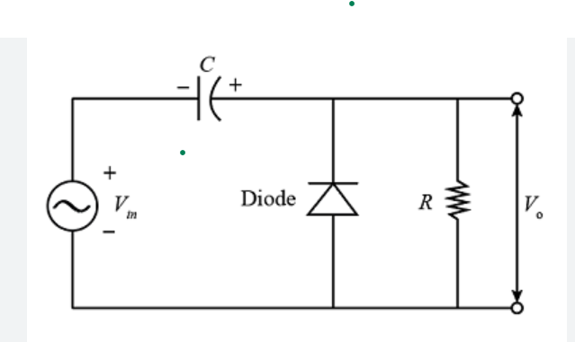
R is the resistance of the resistor employed
C is the capacitance of the capacitor used
D is the diode
Vin is the input voltage

Slide 4
Types Of Clamper Circuit
There are Few Types of Clamper Circuit
Positive Clamper
  Positive Clamper with Positive Vr
  Positive Clamper eith Negative Vr
Negative Clamper
  Negative Clamper with Positive Vr
  Negative Clamper with negative Vr

Slide 5
Positive Clamper Circuit
A Positive Clamper circuit is one that consists of a diode, a resistor and a capacitor and that shifts the output signal to the positive portion of the input signal.
OR
This type of clamper circuit shifts the waveform upwards, so that the lowest point of the waveform is at the V0 reference level.

Slide 6
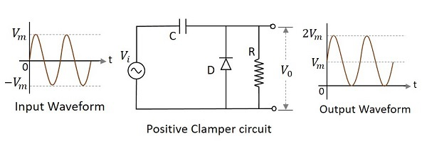
V0=Vi+Vm
Hence the signal is positively clamped as shown in the above figure. The output signal changes according to the changes in the input, but shifts the level according to the charge on the capacitor, as it adds the input voltage.

Slide 7
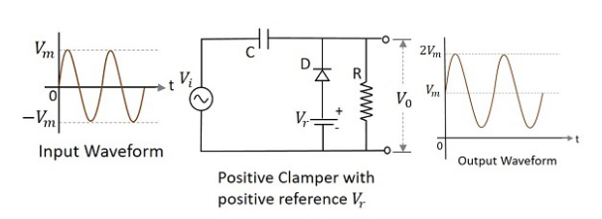
Positive Clamper Circuit with positive Vr

Slide 8
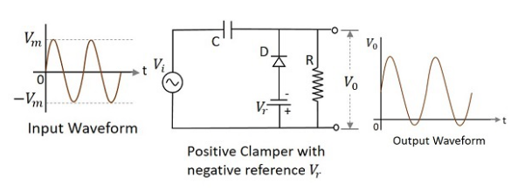
Positive Clamper Circuit with Negative Vr

Slide 9
Negative Clamper Circuit
A Negative Clamper circuit is one that consists of a diode, a resistor and a capacitor and that shifts the output signal to the negative portion of the input signal.
OR
This type of clamper circuit shifts the waveform downwards, so that the highest point of the waveform is at the V0 reference level.

Slide 10
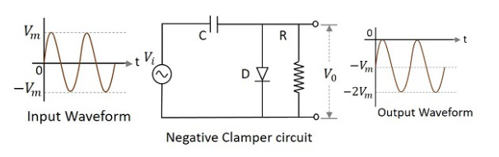
V0=Vi+Vm
Hence the signal is negatively clamped as shown in the above figure. The output signal changes according to the changes in the input, but shifts the level according to the charge on the capacitor, as it adds the input voltage.

Slide 11
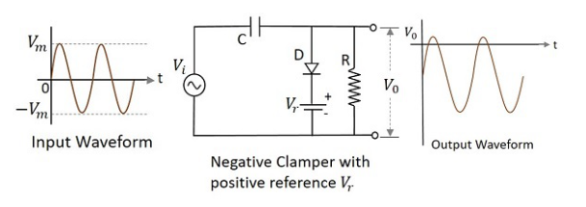
Negative Clamper Circuit with positive Vr

Slide 12
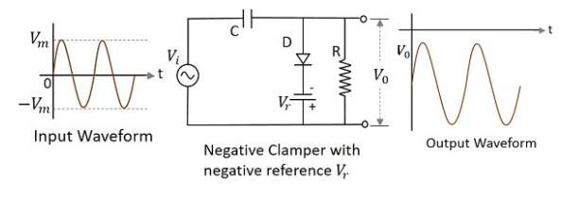
Negative Clamper Circuit with Negative Vr

Slide 13
Applications
There are many applications for Clampers such as
Voltage Multipliers: Clamper circuits are used in voltage multiplier circuits to produce high voltage DC outputs.
2. TV and Radio Circuits: Clamper circuits are used in TV and radio circuits to restore the original DC level of the signal.

Slide 14
Applications
3. Medical Equipment: Clamper circuits are used in medical equipment such as ECG machines to shift the baseline of the signal to a desired level.
4. Data Acquisition Systems: Clamper circuits are used in data acquisition systems to shift the signal to a desired level for processing.
5. Audio Equipment: Clamper circuits are used in audio equipment such as amplifiers and filters to shift the signal to a desired level.

Slide 15
Thank You

